Slide 1
Internship Presentation
Multiple Topics in MobiKa

Slide 2
Agenda
Introduction
Job Description
Results
Summary and Conclusion

Slide 3

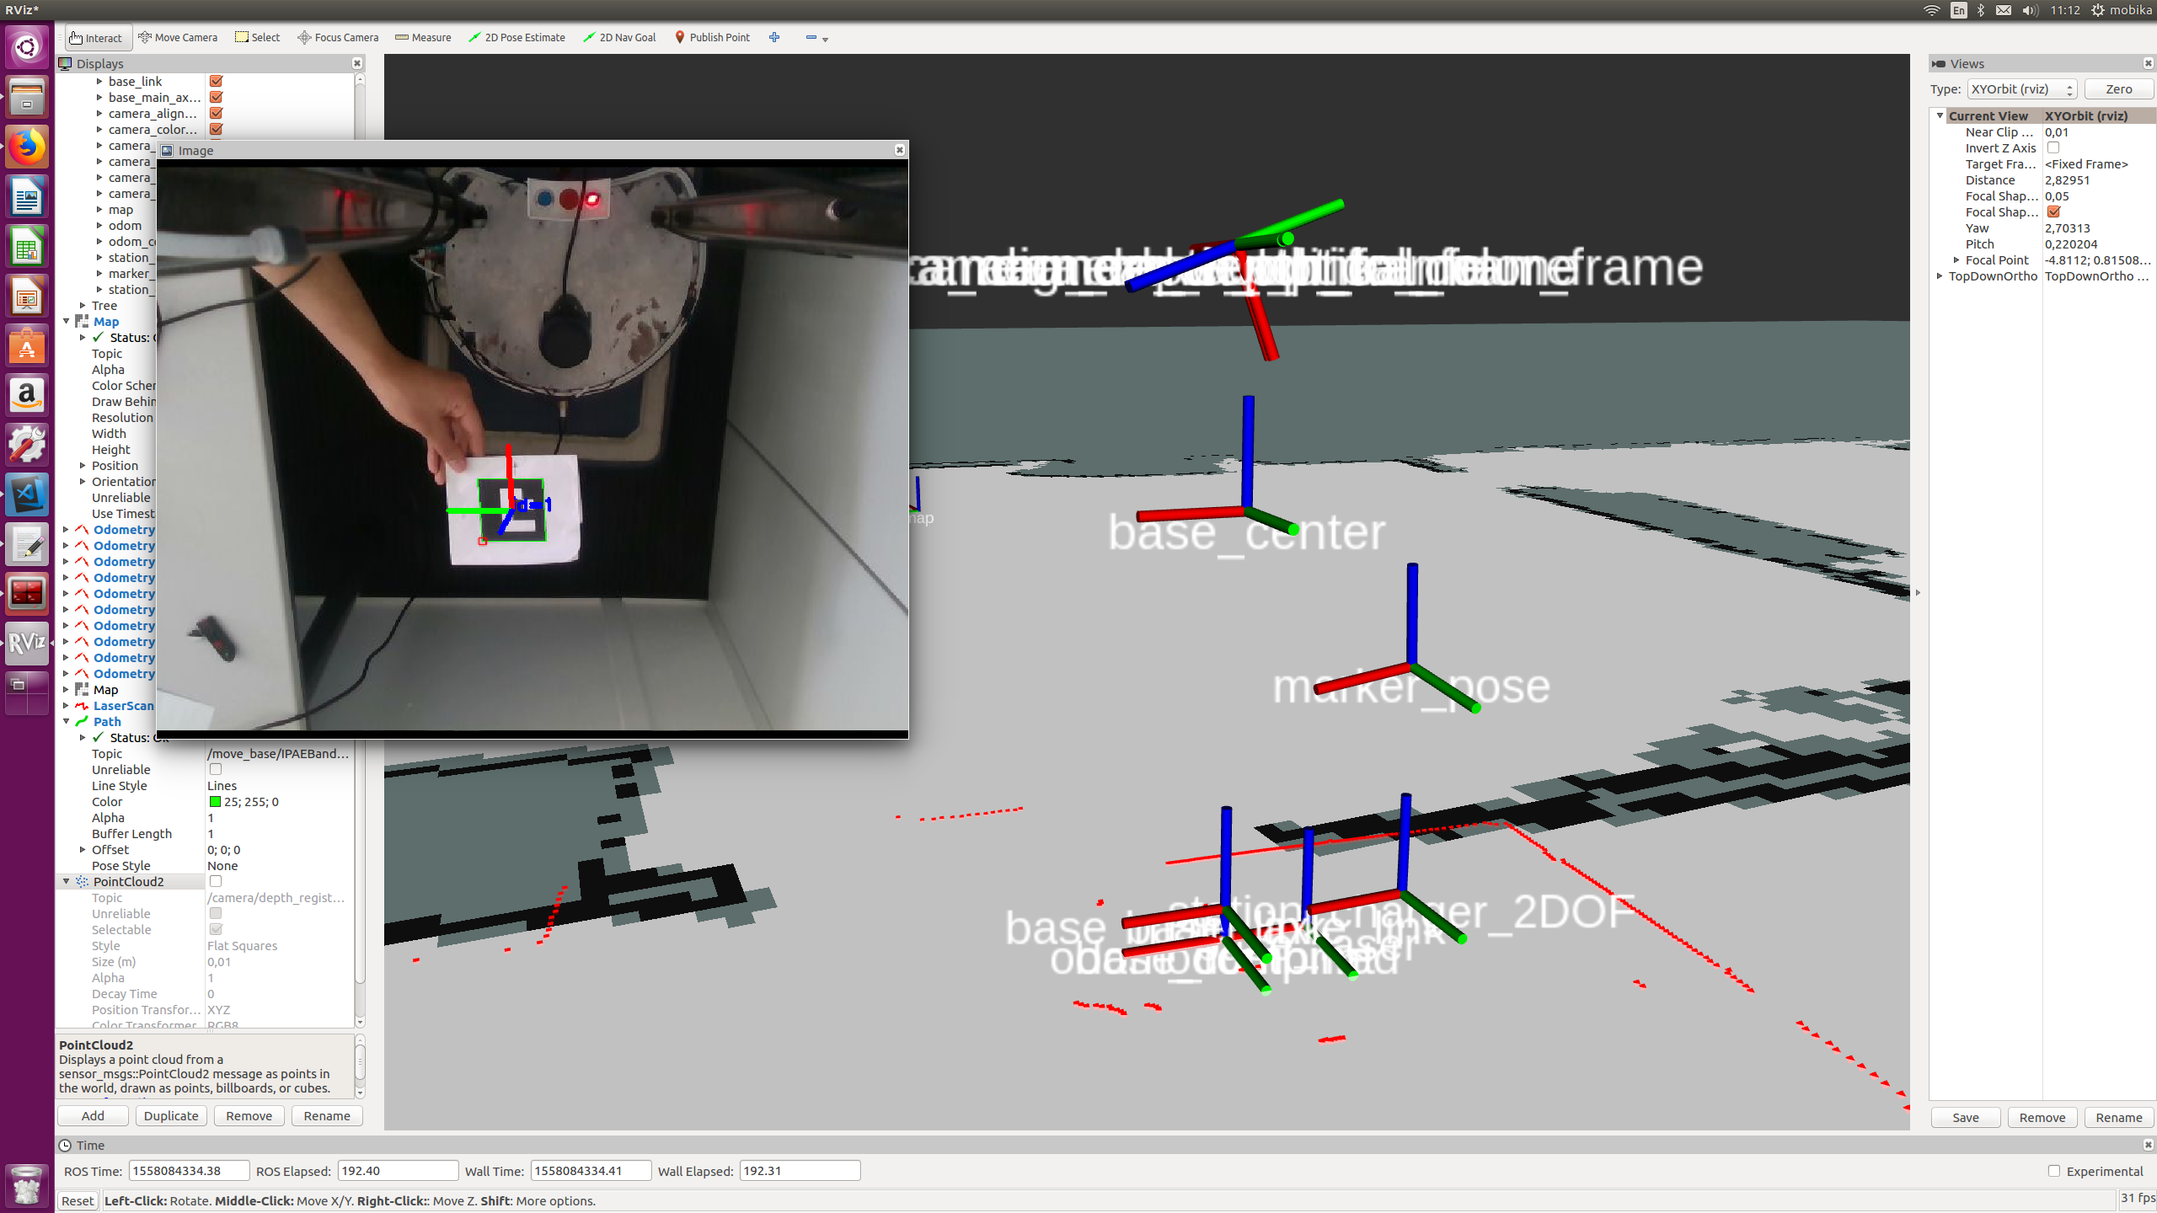
Marker Detection and Pose Estimation
Standard Aruco Marker Library http://wiki.ros.org/aruco_detect to detect the marker
Publishing a TF between camera and the Marker and the 2D pose of the marker
6DOF marker pose
2DOF marker pose

Slide 4
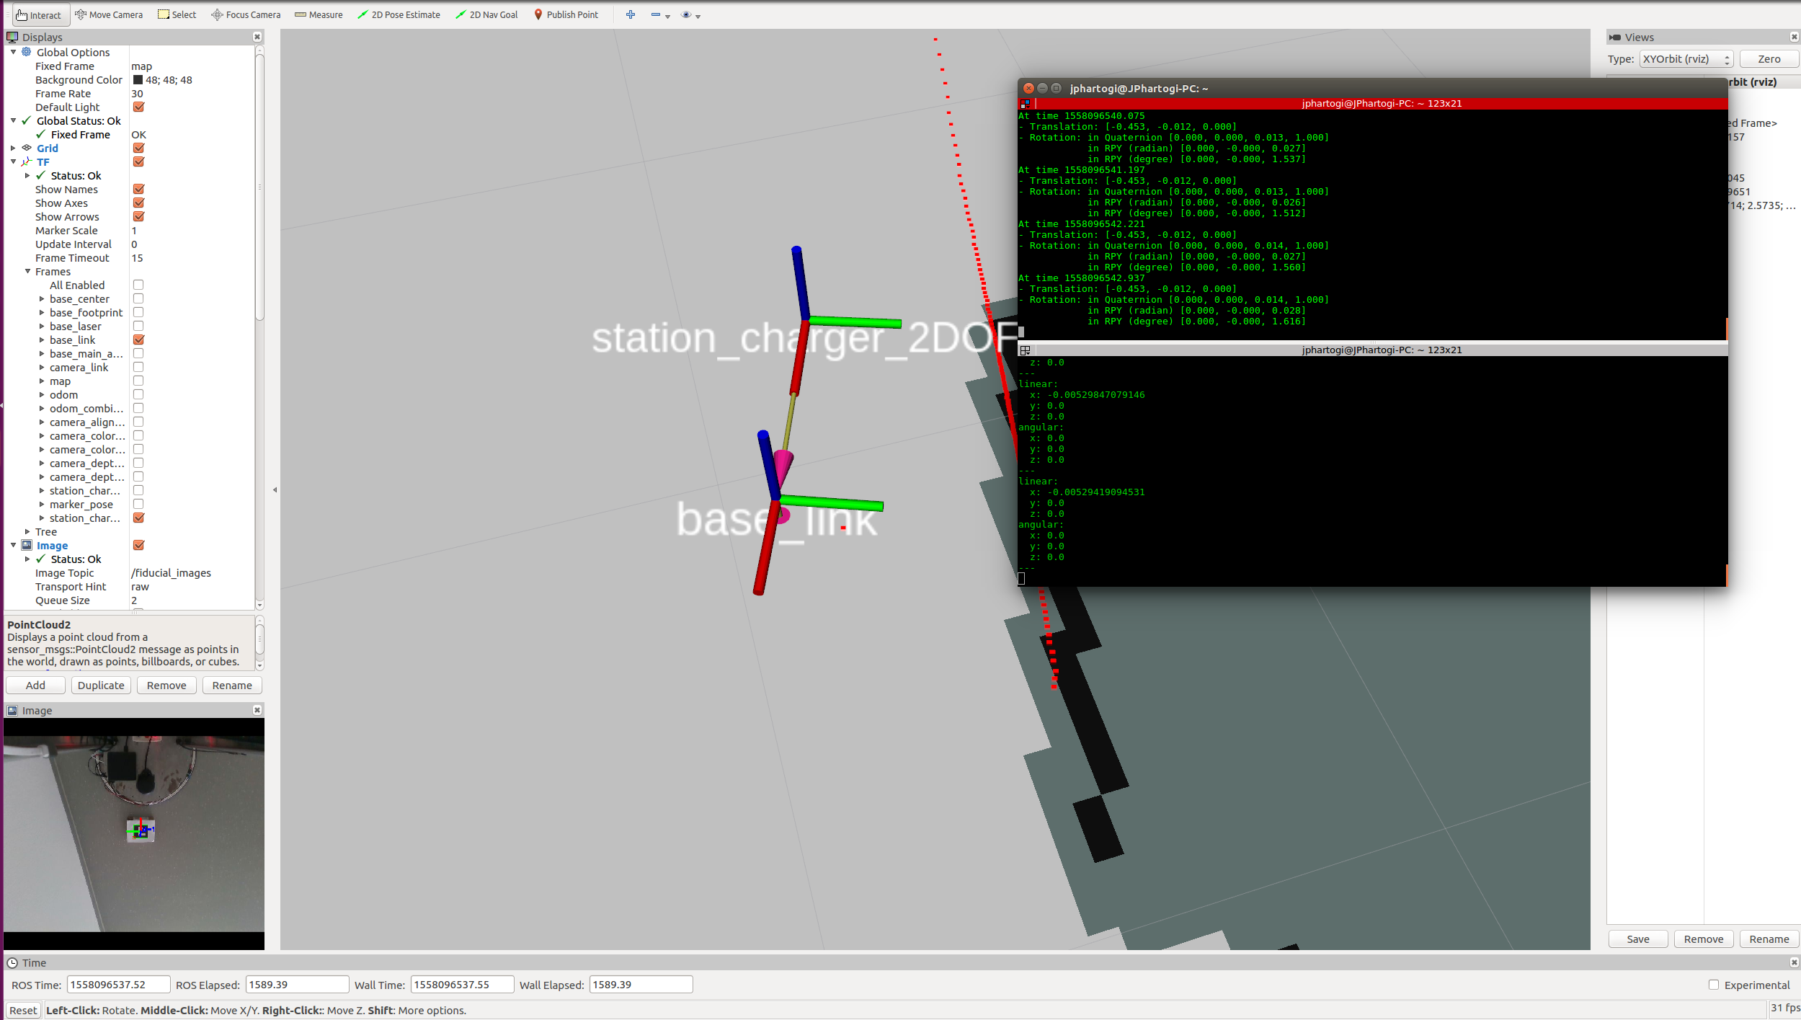
Docking Stations
Implementing and modified the ipa differential docking ( from forward docking to backward docking )
Test docking the robot to the detected marker

Slide 5
Result Video

Slide 6
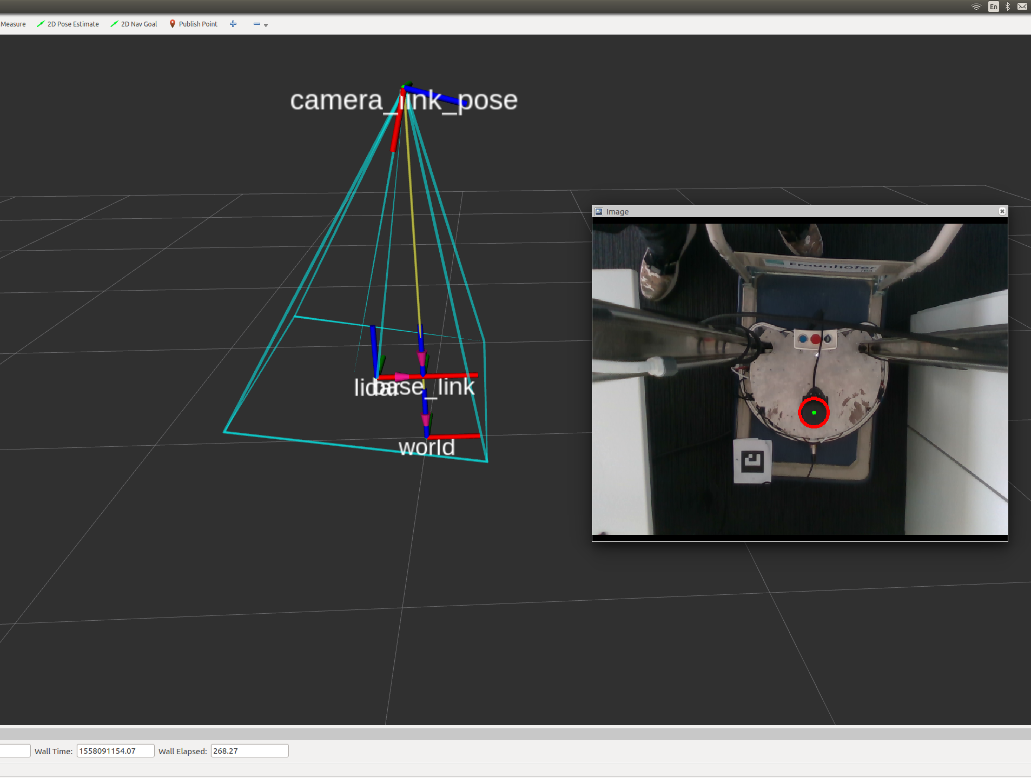
Camera pose estimation result
Using the static feature in the robot ( Lidar ) to detect the pose of the camera
Using the Hough circle transformation https://docs.opencv.org/2.4/doc/tutorials/imgproc/imgtrans/hough_circle/hough_circle.html
Publish the TF of the camera pose

Slide 7
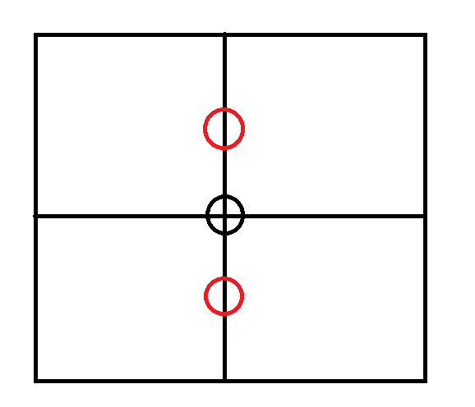
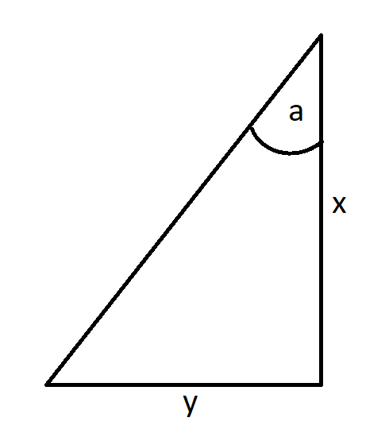

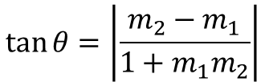



Camera Pose Initialization and Estimation
tan θ = m2−m11+m1m2
$$θ=a−b$$
$$camera angle=\left\{\begin{aligned}\text{a}−θ, y<y_{ref} \\ &\text{a}+θ, y≥y_{ref}\end{aligned}\right.$$
$$\tan{θ=\left|\frac{m_{2}−m_{1}}{{1+m}_{1}m_{2}}\right|}$$
Where $m_{2}$ = Reference gradient (const), and
$m_{1}$ = Detected circle gradient
Camera frame
Camera_link
Detected circle
a (ref angle) = $\tan^{−1}{\frac{y_{ref}}{x_{ref}}}$
reference
y
b
Lidar
x
Base_link
Notes:
Remember!
- It calculated in 2D image, because the movement of the camera is restricted in one direction only. So the detected circle will always be in one line.

Slide 8
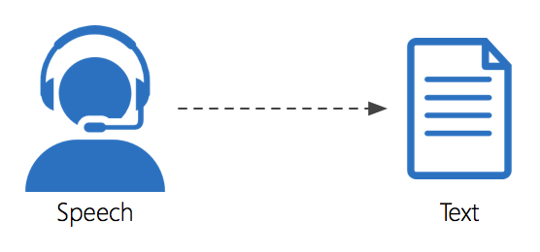
Speech Recognition
Using the online and offline (google and sphinx ) speech recognition and text to speech API
Extracting the speech into data type string, there is lot of possibility to do with the data
Example :
Extract some keywords , ( “ come “, or “ closer “ )
Decision making with yes or no question

Slide 9
Demo Speech Recognition

Slide 10
Tablet Height Control
Using roboclaw motor and encoder to control the motor
Can be called with as service include the desired height
Controlled automatically but also can be controlled with joystick
Add acceleration and deceleration for the tablet speed

Slide 11


Acceleration and decceleration
Constant speed
Accelerate : s$peed=speed+2$
Deccelerate :
When to decelerate ->$\frac{total distance}{(total distance + 5)}$
Decceleration distance = $\left|goal dist −curr dist\right|$
Current speed
s$peed=$
acclerate
deccelerate
Current_dist
Goal_dist

